Slide 1
Chapter 11
I/O Management and Disk Scheduling
Operating Systems:
Internals and Design Principles
Seventh Edition
By William Stallings
Notes:
“Operating Systems: Internal and Design Principles”, 7/e, by William Stallings, Chapter 11 “I/O Management and Disk Scheduling”.

Slide 2

Operating Systems:
Internals and Design Principles
An artifact can be thought of as a meeting point—an “interface” in today’s terms between an “inner” environment, the substance and organization of the artifact itself, and an “outer” environment, the surroundings in which it operates. If the inner environment is appropriate to the outer environment, or vice versa, the artifact will serve its intended purpose.
— THE SCIENCES OF THE ARTIFICIAL,
Herbert Simon
Notes:
Perhaps the messiest aspect of operating system design is input/output. Because
there is such a wide variety of devices and applications of those devices, it is difficult
to develop a general, consistent solution.
We begin this chapter with a brief discussion of I/O devices and the organization
of the I/O functions. These topics, which generally come within the scope of
computer architecture, set the stage for an examination of I/O from the point of view
of the operating system.
The next section examines operating system design issues, including design
objectives, and the way in which the I/O function can be structured. Then I/O
buffering is examined; one of the basic I/O services provided by the operating
system is a buffering function, which improves overall performance.
The next sections of the chapter are devoted to magnetic disk I/O. In contemporary
systems, this form of I/O is the most important and is key to the performance as perceived
by the user. We begin by developing a model of disk I/O performance and then
examine several techniques that can be used to enhance performance.
Appendix J summarizes characteristics of secondary storage devices, including
magnetic disk and optical memory.

Slide 3


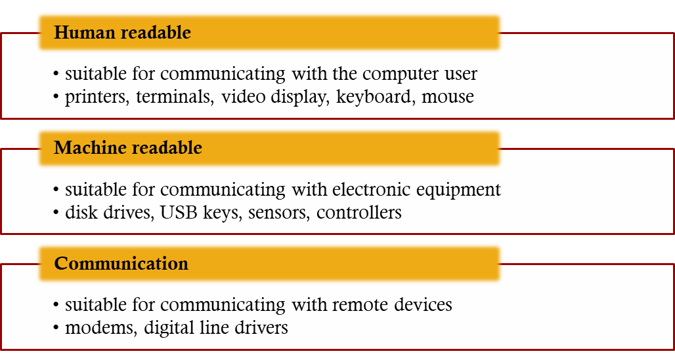
External devices that engage in I/O with computer systems can be grouped into three categories:
Notes:
As was mentioned in Chapter 1 , external devices that engage in I/O with computer
systems can be roughly grouped into three categories:
• Human readable: Suitable for communicating with the computer user.
Examples include printers and terminals, the latter consisting of video display,
keyboard, and perhaps other devices such as a mouse.
Machine readable: Suitable for communicating with electronic equipment.
Examples are disk drives, USB keys, sensors, controllers, and actuators.
• Communication: Suitable for communicating with remote devices. Examples
are digital line drivers and modems.

Slide 4

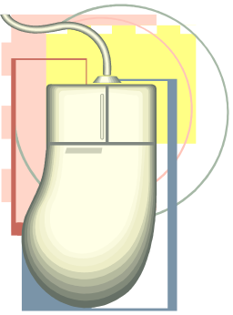
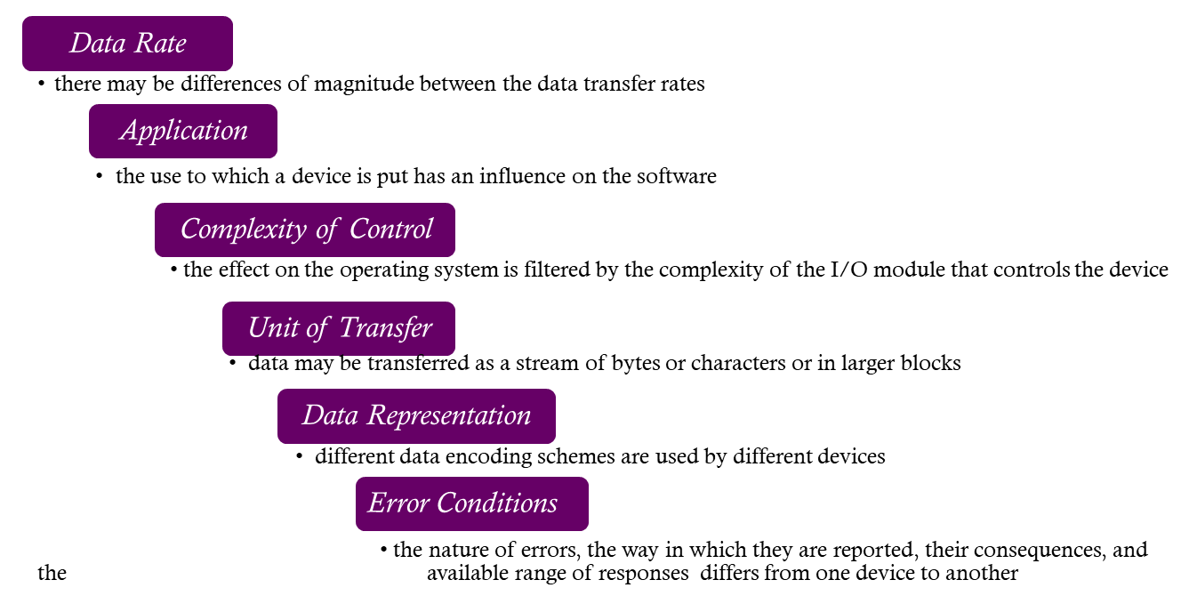
Devices differ in a number of areas:
Notes:
There are great differences across classes and even substantial differences
within each class. Among the key differences are the following:
• Data rate: There may be differences of several orders of magnitude between
the data transfer rates. Figure 11.1 gives some examples.
• Application: The use to which a device is put has an influence on the software
and policies in the operating system and supporting utilities. For example, a
disk used for files requires the support of file management software. A disk
used as a backing store for pages in a virtual memory scheme depends on the
use of virtual memory hardware and software. Furthermore, these applications
have an impact on disk scheduling algorithms (discussed later in this
chapter). As another example, a terminal may be used by an ordinary user or a
system administrator. These uses imply different privilege levels and perhaps
different priorities in the operating system.
• Complexity of control: A printer requires a relatively simple control interface.
A disk is much more complex. The effect of these differences on the operating
system is filtered to some extent by the complexity of the I/O module that
controls the device, as discussed in the next section.
Unit of transfer: Data may be transferred as a stream of bytes or characters
(e.g., terminal I/O) or in larger blocks (e.g., disk I/O).
• Data representation: Different data encoding schemes are used by different
devices, including differences in character code and parity conventions.
• Error conditions: The nature of errors, the way in which they are reported,
their consequences, and the available range of responses differ widely from
one device to another.
This diversity makes a uniform and consistent approach to I/O, both from the
point of view of the operating system and from the point of view of user processes,
difficult to achieve.

Slide 5


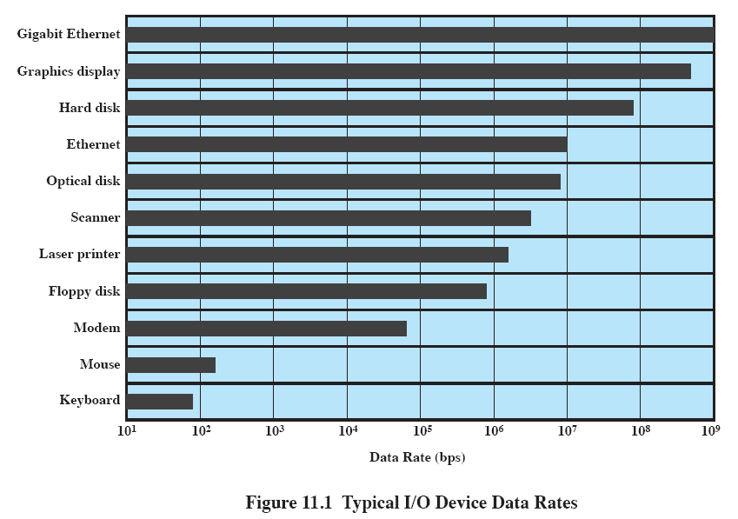
Notes:
There may be differences of several orders of magnitude between the data transfer rates.
Figure 11.1 gives some examples.

Slide 6

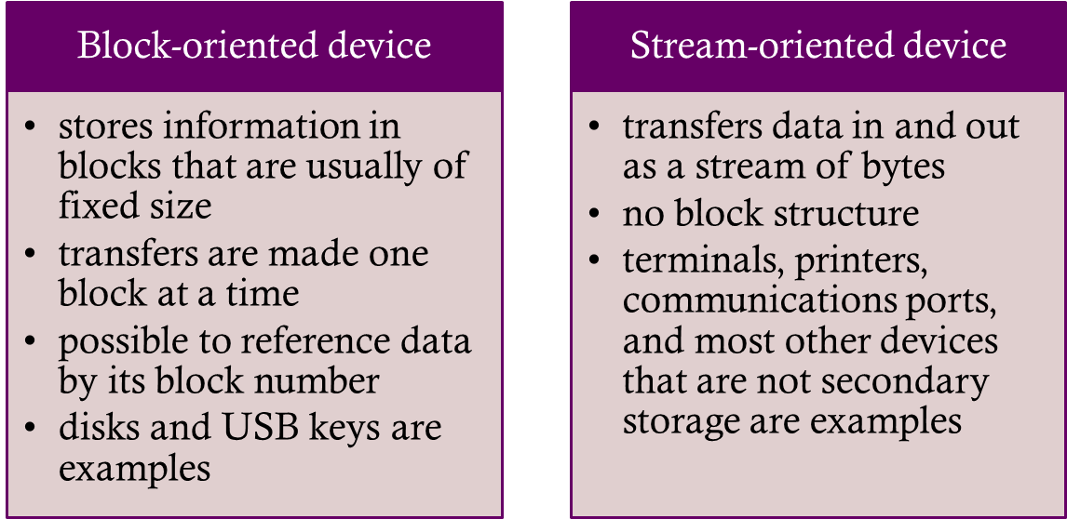
Perform input transfers in advance of requests being made and perform output transfers some time after the request is made
Notes:
The same considerations apply to an output operation. If a block is being
transferred from a user process area directly to an I/O module, then the process is
blocked during the transfer and the process may not be swapped out.
To avoid these overheads and inefficiencies, it is sometimes convenient to
perform input transfers in advance of requests being made and to perform output
transfers some time after the request is made. This technique is known as buffering.
In this section, we look at some of the buffering schemes that are supported by
operating systems to improve the performance of the system.
In discussing the various approaches to buffering, it is sometimes important
to make a distinction between two types of I/O devices: block oriented and stream
oriented. A block-oriented device stores information in blocks that are usually of
fixed size, and transfers are made one block at a time. Generally, it is possible to
reference data by its block number. Disks and USB keys are examples of block oriented
devices. A stream-oriented device transfers data in and out as a stream of
bytes, with no block structure. Terminals, printers, communications ports, mouse
and other pointing devices, and most other devices that are not secondary storage
are stream oriented.

Slide 7
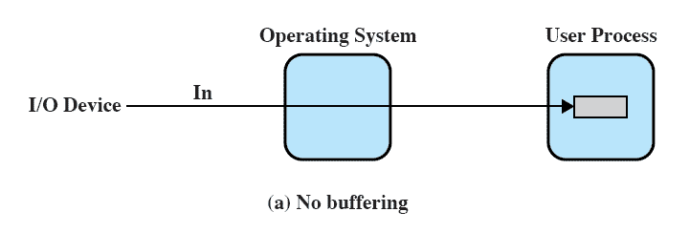
No Buffer
Without a buffer, the OS directly accesses the device when it needs
Notes:
Without a buffer, the OS directly accesses the device when it needs to.

Slide 8
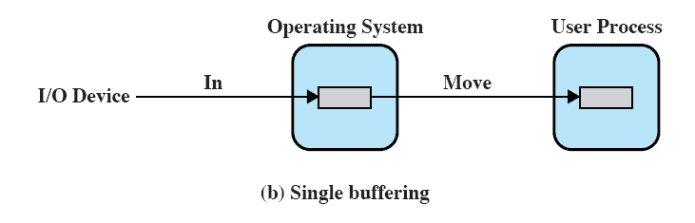
Single Buffer
Operating system assigns a buffer in main memory for an I/O request
Notes:
The simplest type of support that the operating system can provide is single buffering
( Figure 11.5b ). When a user process issues an I/O request, the OS assigns a buffer in
the system portion of main memory to the operation.
In the case of line-at-a-time I/O, the buffer can be used to hold a single line.
The user process is suspended during input, awaiting the arrival of the entire line.
For output, the user process can place a line of output in the buffer and continue
processing. It need not be suspended unless it has a second line of output to send
before the buffer is emptied from the first output operation. In the case of byte-at-a-time
I/O, the interaction between the OS and the user process follows the producer/
consumer model discussed in Chapter 5 .

Slide 9
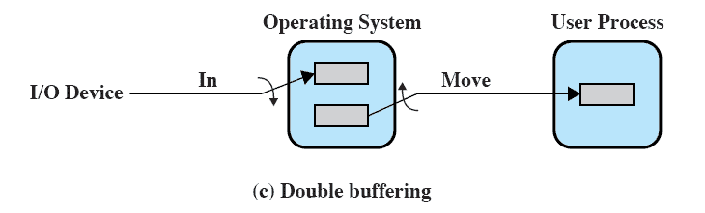
Double Buffer
Use two system buffers instead of one
A process can transfer data to or from one buffer while the operating system empties or fills the other buffer
Also known as buffer swapping
Notes:
An improvement over single buffering can be had by assigning two system buffers to
the operation ( Figure 11.5c ). A process now transfers data to (or from) one buffer
while the operating system empties (or fills) the other. This technique is known as
double buffering or buffer swapping .
For block-oriented transfer, we can roughly estimate the execution time as
max [ C , T ]. It is therefore possible to keep the block-oriented device going at full
speed if C … T . On the other hand, if C 7 T , double buffering ensures that the
process will not have to wait on I/O. In either case, an improvement over single
buffering is achieved. Again, this improvement comes at the cost of increased
complexity.
For stream-oriented input, we again are faced with the two alternative modes
of operation. For line-at-a-time I/O, the user process need not be suspended for
input or output, unless the process runs ahead of the double buffers. For byte-at-atime
operation, the double buffer offers no particular advantage over a single buffer
of twice the length. In both cases, the producer/consumer model is followed.

Slide 10
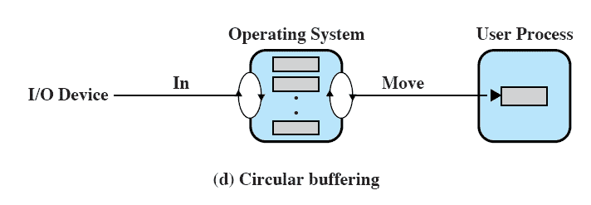
Circular Buffer
Two or more buffers are used
Each individual buffer is one unit in a circular buffer
Used when I/O operation must keep up with process
Notes:
A double-buffer scheme should smooth out the flow of data between an I/O device
and a process. If the performance of a particular process is the focus of our concern,
then we would like for the I/O operation to be able to keep up with the process.
Double buffering may be inadequate if the process performs rapid bursts of I/O. In
this case, the problem can often be alleviated by using more than two buffers.
When more than two buffers are used, the collection of buffers is itself referred
to as a circular buffer ( Figure 11.5d ), with each individual buffer being one unit in
the circular buffer. This is simply the bounded-buffer producer/consumer model
studied in Chapter 5 .

Slide 11



Technique that smoothes out peaks in I/O demand
  with enough demand eventually all buffers become full and their advantage is lost
When there is a variety of I/O and process activities to service, buffering can increase the efficiency of the OS and the performance of individual processes
Notes:
Buffering is a technique that smoothes out peaks in I/O demand. However, no
amount of buffering will allow an I/O device to keep pace with a process indefinitely
when the average demand of the process is greater than the I/O device can
service. Even with multiple buffers, all of the buffers will eventually fill up and the
process will have to wait after processing each chunk of data. However, in a multiprogramming
environment, when there is a variety of I/O activity and a variety of
process activity to service, buffering is one tool that can increase the efficiency of
the operating system and the performance of individual processes.

Slide 12

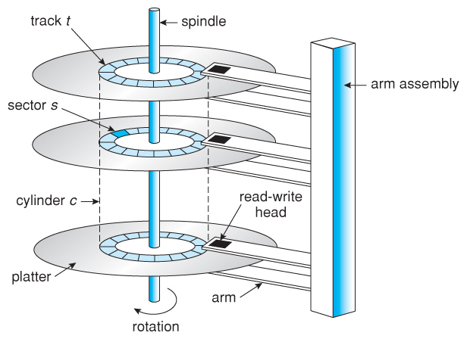
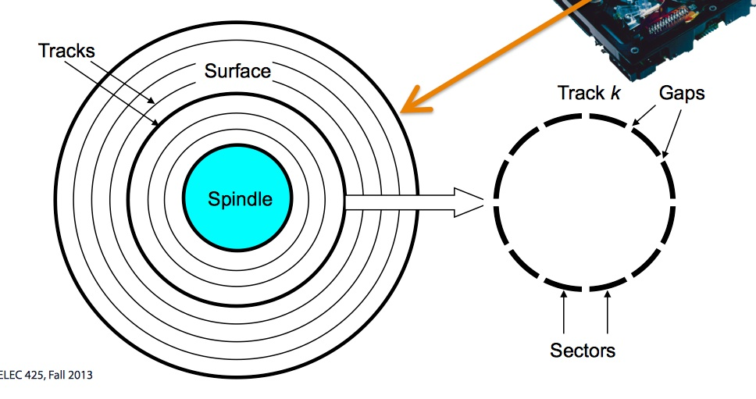
Platter-> Surface-> Tracks -> Sector -> Data
Notes:
Buffering is a technique that smoothes out peaks in I/O demand. However, no
amount of buffering will allow an I/O device to keep pace with a process indefinitely
when the average demand of the process is greater than the I/O device can
service. Even with multiple buffers, all of the buffers will eventually fill up and the
process will have to wait after processing each chunk of data. However, in a multiprogramming
environment, when there is a variety of I/O activity and a variety of
process activity to service, buffering is one tool that can increase the efficiency of
the operating system and the performance of individual processes.

Slide 13
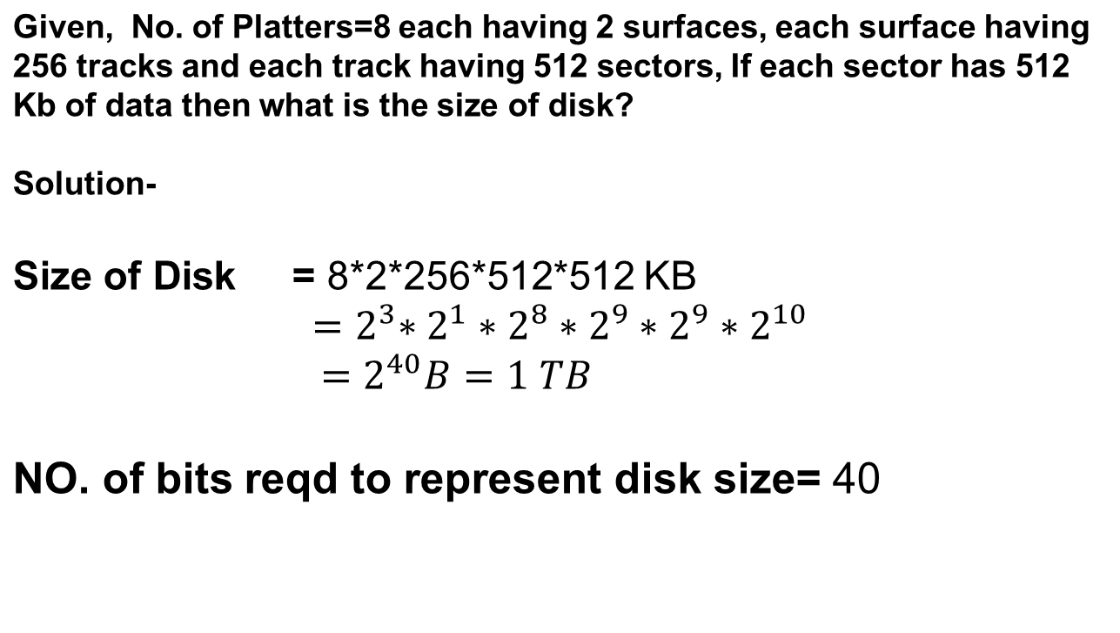
Platter-> Surface-> Tracks -> Sector -> Data
Notes:
Buffering is a technique that smoothes out peaks in I/O demand. However, no
amount of buffering will allow an I/O device to keep pace with a process indefinitely
when the average demand of the process is greater than the I/O device can
service. Even with multiple buffers, all of the buffers will eventually fill up and the
process will have to wait after processing each chunk of data. However, in a multiprogramming
environment, when there is a variety of I/O activity and a variety of
process activity to service, buffering is one tool that can increase the efficiency of
the operating system and the performance of individual processes.

Slide 14
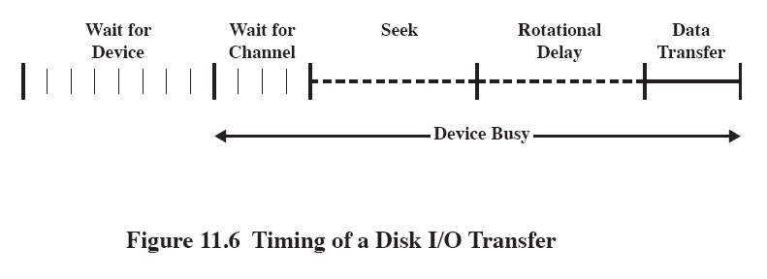
Disk Performance Parameters
The actual details of disk I/O operation depend on the:
    computer system
    operating system
    nature of the I/O channel and disk controller hardware
Notes:
The actual details of disk I/O operation depend on the computer system, the operating
system, and the nature of the I/O channel and disk controller hardware. A
general timing diagram of disk I/O transfer is shown in Figure 11.6 .

Slide 15

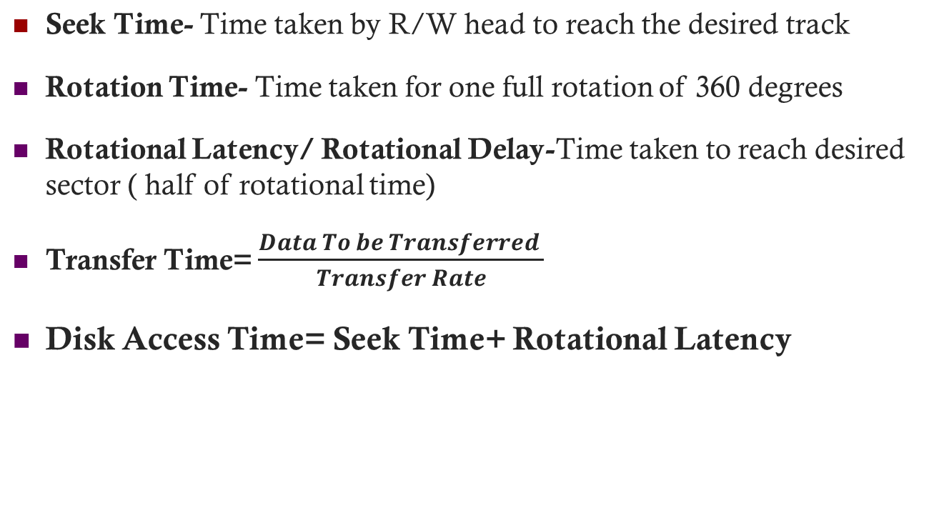
Notes:
When the disk drive is operating, the disk is rotating at constant speed. To
read or write, the head must be positioned at the desired track and at the beginning
of the desired sector on that track. 1 Track selection involves moving the head in a
movable-head system or electronically selecting one head on a fixed-head system.
On a movable-head system, the time it takes to position the head at the track is
known as seek time . In either case, once the track is selected, the disk controller
waits until the appropriate sector rotates to line up with the head. The time it takes
for the beginning of the sector to reach the head is known as rotational delay , or
rotational latency. The sum of the seek time, if any, and the rotational delay equals
the access time , which is the time it takes to get into position to read or write. Once
the head is in position, the read or write operation is then performed as the sector
moves under the head; this is the data transfer portion of the operation; the time
required for the transfer is the transfer time .
In addition to the access time and transfer time, there are several queuing
delays normally associated with a disk I/O operation. When a process issues an
I/O request, it must first wait in a queue for the device to be available. At that
time, the device is assigned to the process. If the device shares a single I/O channel
or a set of I/O channels with other disk drives, then there may be an additional
wait for the channel to be available. At that point, the seek is performed to begin
disk access.
In some high-end systems for servers, a technique known as rotational
positional sensing (RPS) is used. This works as follows: When the seek command
has been issued, the channel is released to handle other I/O operations. When
the seek is completed, the device determines when the data will rotate under
the head. As that sector approaches the head, the device tries to reestablish the
communication path back to the host. If either the control unit or the channel is
busy with another I/O, then the reconnection attempt fails and the device must
rotate one whole revolution before it can attempt to reconnect, which is called
an RPS miss. This is an extra delay element that must be added to the time line
of Figure 11.6 .

Slide 16

Goal of disk scheduling algorithm is to minimize seek time.
Disk Scheduling algorithms are-
  First In First Out (FIFO)
  Shortest Seek Time First (SSTF)
  SCAN
  LOOK
  CSCAN
Notes:
When the disk drive is operating, the disk is rotating at constant speed. To
read or write, the head must be positioned at the desired track and at the beginning
of the desired sector on that track. 1 Track selection involves moving the head in a
movable-head system or electronically selecting one head on a fixed-head system.
On a movable-head system, the time it takes to position the head at the track is
known as seek time . In either case, once the track is selected, the disk controller
waits until the appropriate sector rotates to line up with the head. The time it takes
for the beginning of the sector to reach the head is known as rotational delay , or
rotational latency. The sum of the seek time, if any, and the rotational delay equals
the access time , which is the time it takes to get into position to read or write. Once
the head is in position, the read or write operation is then performed as the sector
moves under the head; this is the data transfer portion of the operation; the time
required for the transfer is the transfer time .
In addition to the access time and transfer time, there are several queuing
delays normally associated with a disk I/O operation. When a process issues an
I/O request, it must first wait in a queue for the device to be available. At that
time, the device is assigned to the process. If the device shares a single I/O channel
or a set of I/O channels with other disk drives, then there may be an additional
wait for the channel to be available. At that point, the seek is performed to begin
disk access.
In some high-end systems for servers, a technique known as rotational
positional sensing (RPS) is used. This works as follows: When the seek command
has been issued, the channel is released to handle other I/O operations. When
the seek is completed, the device determines when the data will rotate under
the head. As that sector approaches the head, the device tries to reestablish the
communication path back to the host. If either the control unit or the channel is
busy with another I/O, then the reconnection attempt fails and the device must
rotate one whole revolution before it can attempt to reconnect, which is called
an RPS miss. This is an extra delay element that must be added to the time line
of Figure 11.6 .

Slide 17
First-In, First-Out (FIFO)
Processes in sequential order
Fair to all processes
Approximates random scheduling in performance if there are many processes competing for the disk
Notes:
The simplest form of scheduling is first-in-first-out (FIFO)
scheduling, which processes items from the queue in sequential order. This strategy
has the advantage of being fair, because every request is honored and the requests are
honored in the order received. Figure 11.7a illustrates the disk arm movement with
FIFO. This graph is generated directly from the data in Table 11.2a . As can be seen,
the disk accesses are in the same order as the requests were originally received.
With FIFO, if there are only a few processes that require access and if many
of the requests are to clustered file sectors, then we can hope for good performance.
However, this technique will often approximate random scheduling in performance,
if there are many processes competing for the disk. Thus, it may be profitable to
consider a more sophisticated scheduling policy. A number of these are listed in
Table 11.3 and will now be considered.

Slide 18
First-In, First-Out (FIFO)
A disk contains 200 tracks (0-199). Request queue contains track no.
82, 170, 43,140, 24, 16, 190 respectively. Current position of R/W head is 50. Calculate total no. of track movements by R/W head using FIFO.
Total No. of track Movements= (82-50)+(170-82)+(170-43)+(140-43) +(140-24)+(24-16)+(190-16)=
0
50
199
82
43
170
140
16
24
190
Notes:
The simplest form of scheduling is first-in-first-out (FIFO)
scheduling, which processes items from the queue in sequential order. This strategy
has the advantage of being fair, because every request is honored and the requests are
honored in the order received. Figure 11.7a illustrates the disk arm movement with
FIFO. This graph is generated directly from the data in Table 11.2a . As can be seen,
the disk accesses are in the same order as the requests were originally received.
With FIFO, if there are only a few processes that require access and if many
of the requests are to clustered file sectors, then we can hope for good performance.
However, this technique will often approximate random scheduling in performance,
if there are many processes competing for the disk. Thus, it may be profitable to
consider a more sophisticated scheduling policy. A number of these are listed in
Table 11.3 and will now be considered.

Slide 19
Shortest Service Time First (SSTF)
Select the disk I/O request that requires the least movement of the disk arm from its current position
Always choose the minimum seek time
Always choosing the minimum seek time does not guarantee that the average seek time over a number of arm movements will be minimum.
Provides better performance than FIFO
May lead to starvation
Notes:
The shortest-service-time-first (SSTF) policy
is to select the disk I/O request that requires the least movement of the disk arm
from its current position. Thus, we always choose to incur the minimum seek time.
Of course, always choosing the minimum seek time does not guarantee that the
average seek time over a number of arm movements will be minimum. However,
this should provide better performance than FIFO. Because the arm can move in
two directions, a random tie-breaking algorithm may be used to resolve cases of
equal distances.
Figure 11.7b and Table 11.2b show the performance of SSTF on the same
example as was used for FIFO. The first track accessed is 90, because this is the
closest requested track to the starting position. The next track accessed is 58 because
this is the closest of the remaining requested tracks to the current position of 90.
Subsequent tracks are selected accordingly.

Slide 20
Shortest Service Time First (SSTF)
A disk contains 200 tracks (0-199). Request queue contains track no.
82, 170, 43,140, 24, 16, 190 respectively. Current position of R/W head is 50. Calculate total no. of track movements by R/W head using SSTF.
Total No. of track Movements= (50-43)+(43-24)+(24-16)+(82-16) +(140-82)+(170-140)+(190-170)=208
0
50
199
43
24
16
82
140
170
190
Notes:
The simplest form of scheduling is first-in-first-out (FIFO)
scheduling, which processes items from the queue in sequential order. This strategy
has the advantage of being fair, because every request is honored and the requests are
honored in the order received. Figure 11.7a illustrates the disk arm movement with
FIFO. This graph is generated directly from the data in Table 11.2a . As can be seen,
the disk accesses are in the same order as the requests were originally received.
With FIFO, if there are only a few processes that require access and if many
of the requests are to clustered file sectors, then we can hope for good performance.
However, this technique will often approximate random scheduling in performance,
if there are many processes competing for the disk. Thus, it may be profitable to
consider a more sophisticated scheduling policy. A number of these are listed in
Table 11.3 and will now be considered.

Slide 21
SCAN
Also known as the elevator algorithm
Arm moves in one direction only
    satisfies all outstanding requests until it reaches the last track in that direction then the direction is reversed
  Favors jobs whose requests are for tracks nearest to both innermost and outermost tracks
Notes:
With the exception of FIFO, all of the policies described so far can leave
some request unfulfilled until the entire queue is emptied. That is, there may always
be new requests arriving that will be chosen before an existing request. A simple
alternative that prevents this sort of starvation is the SCAN algorithm, also known
as the elevator algorithm because it operates much the way an elevator does.
With SCAN, the arm is required to move in one direction only, satisfying all
outstanding requests en route, until it reaches the last track in that direction or until
there are no more requests in that direction. This latter refinement is sometimes
referred to as the LOOK policy. The service direction is then reversed and the scan
proceeds in the opposite direction, again picking up all requests in order.
Figure 11.7c and Table 11.2c illustrate the SCAN policy. Assuming that the
initial direction is of increasing track number, then the first track selected is 150,
since this is the closest track to the starting track of 100 in the increasing direction.
As can be seen, the SCAN policy behaves almost identically with the SSTF
policy. Indeed, if we had assumed that the arm was moving in the direction of lower
track numbers at the beginning of the example, then the scheduling pattern would
have been identical for SSTF and SCAN. However, this is a static example in which
no new items are added to the queue. Even when the queue is dynamically changing,
SCAN will be similar to SSTF unless the request pattern is unusual.
Note that the SCAN policy is biased against the area most recently traversed.
Thus it does not exploit locality as well as SSTF.
It is not difficult to see that the SCAN policy favors jobs whose requests are
for tracks nearest to both innermost and outermost tracks and favors the latest arriving
jobs. The first problem can be avoided via the C-SCAN policy, while the
second problem is addressed by the N-step-SCAN policy.

Slide 22
SCAN
A disk contains 200 tracks (0-199). Request queue contains track no.
82, 170, 43,140, 24, 16, 190 respectively. Current position of R/W head is 50 and Direction is set as UP. Calculate total no. of track movements by R/W head using SCAN.
Total No. of track Movements= (82-50)+(140-82)+(170-140)+(190-170) +(199-190)+(199-43)+(43-24)+(24-16)=332
0
50
199
82
140
170
190
199
43
24
16
Notes:
The simplest form of scheduling is first-in-first-out (FIFO)
scheduling, which processes items from the queue in sequential order. This strategy
has the advantage of being fair, because every request is honored and the requests are
honored in the order received. Figure 11.7a illustrates the disk arm movement with
FIFO. This graph is generated directly from the data in Table 11.2a . As can be seen,
the disk accesses are in the same order as the requests were originally received.
With FIFO, if there are only a few processes that require access and if many
of the requests are to clustered file sectors, then we can hope for good performance.
However, this technique will often approximate random scheduling in performance,
if there are many processes competing for the disk. Thus, it may be profitable to
consider a more sophisticated scheduling policy. A number of these are listed in
Table 11.3 and will now be considered.

Slide 23
C-SCAN (Circular SCAN)
Restricts scanning to one direction only
When the last track has been visited in one direction, the arm is returned to the opposite end of the disk and the scan begins again
This reduces the maximum delay experienced by new requests. With SCAN, if the expected time for a scan from inner track to outer track is t , then the expected service interval for sectors at the periphery is 2 t. With C-SCAN, the interval is on the order of t + s max , where s max is the maximum seek time.
The only difference with respect to SCAN algorithm is that, it is designed to provide more uniformity in waiting time
Notes:
The C-SCAN (circular SCAN) policy restricts scanning to one direction
only. Thus, when the last track has been visited in one direction, the arm is returned
to the opposite end of the disk and the scan begins again. This reduces the maximum
delay experienced by new requests. With SCAN, if the expected time for a scan
from inner track to outer track is t , then the expected service interval for sectors at
the periphery is 2 t. With C-SCAN, the interval is on the order of t + s max , where
s max is the maximum seek time.
Figure 11.7d and Table 11.2d illustrate C-SCAN behavior. In this case the first
three requested tracks encountered are 150, 160, and 184. Then the scan begins
starting at the lowest track number, and the next requested track encountered is 18.

Slide 24
C SCAN
A disk contains 200 tracks (0-199). Request queue contains track no.
82, 170, 43,140, 24, 16, 190 respectively. Current position of R/W head is 50 and Direction is set as UP. Calculate total no. of track movements by R/W head using CSCAN.
Total No. of track Movements= (82-50)+(140-82)+(170-140)+(190-170) +(199-190)+(199-0)+(16-0)+(24-16)+(43-24)=391
0
50
199
82
140
170
190
199
0
16
24
43
Notes:
The simplest form of scheduling is first-in-first-out (FIFO)
scheduling, which processes items from the queue in sequential order. This strategy
has the advantage of being fair, because every request is honored and the requests are
honored in the order received. Figure 11.7a illustrates the disk arm movement with
FIFO. This graph is generated directly from the data in Table 11.2a . As can be seen,
the disk accesses are in the same order as the requests were originally received.
With FIFO, if there are only a few processes that require access and if many
of the requests are to clustered file sectors, then we can hope for good performance.
However, this technique will often approximate random scheduling in performance,
if there are many processes competing for the disk. Thus, it may be profitable to
consider a more sophisticated scheduling policy. A number of these are listed in
Table 11.3 and will now be considered.

Slide 25
LOOK
LOOK Algorithm is an improved version of the SCAN Algorithm.
Head starts from the first request at one end of the disk and moves towards the last request at the other end servicing all the requests in between.
After reaching the last request at the other end, head reverses its direction.
It then returns to the first request at the starting end servicing all the requests in between.
Notes:
With the exception of FIFO, all of the policies described so far can leave
some request unfulfilled until the entire queue is emptied. That is, there may always
be new requests arriving that will be chosen before an existing request. A simple
alternative that prevents this sort of starvation is the SCAN algorithm, also known
as the elevator algorithm because it operates much the way an elevator does.
With SCAN, the arm is required to move in one direction only, satisfying all
outstanding requests en route, until it reaches the last track in that direction or until
there are no more requests in that direction. This latter refinement is sometimes
referred to as the LOOK policy. The service direction is then reversed and the scan
proceeds in the opposite direction, again picking up all requests in order.
Figure 11.7c and Table 11.2c illustrate the SCAN policy. Assuming that the
initial direction is of increasing track number, then the first track selected is 150,
since this is the closest track to the starting track of 100 in the increasing direction.
As can be seen, the SCAN policy behaves almost identically with the SSTF
policy. Indeed, if we had assumed that the arm was moving in the direction of lower
track numbers at the beginning of the example, then the scheduling pattern would
have been identical for SSTF and SCAN. However, this is a static example in which
no new items are added to the queue. Even when the queue is dynamically changing,
SCAN will be similar to SSTF unless the request pattern is unusual.
Note that the SCAN policy is biased against the area most recently traversed.
Thus it does not exploit locality as well as SSTF.
It is not difficult to see that the SCAN policy favors jobs whose requests are
for tracks nearest to both innermost and outermost tracks and favors the latest arriving
jobs. The first problem can be avoided via the C-SCAN policy, while the
second problem is addressed by the N-step-SCAN policy.

Slide 26
LOOK
A disk contains 200 tracks (0-199). Request queue contains track no.
82, 170, 43,140, 24, 16, 190 respectively. Current position of R/W head is 50 and Direction is set as UP. Calculate total no. of track movements by R/W head using LOOK.
Total No. of track Movements= (82-50)+(140-82)+(170-140)+(190-170) + (190-43)+(43-24)+(24-16)=332
0
50
199
82
140
170
190
43
24
16
Notes:
The simplest form of scheduling is first-in-first-out (FIFO)
scheduling, which processes items from the queue in sequential order. This strategy
has the advantage of being fair, because every request is honored and the requests are
honored in the order received. Figure 11.7a illustrates the disk arm movement with
FIFO. This graph is generated directly from the data in Table 11.2a . As can be seen,
the disk accesses are in the same order as the requests were originally received.
With FIFO, if there are only a few processes that require access and if many
of the requests are to clustered file sectors, then we can hope for good performance.
However, this technique will often approximate random scheduling in performance,
if there are many processes competing for the disk. Thus, it may be profitable to
consider a more sophisticated scheduling policy. A number of these are listed in
Table 11.3 and will now be considered.

Slide 27
C-LOOK (Circular LOOK)
Circular-LOOK Algorithm is an improved version of the LOOK Algorithm.
Head starts from the first request at one end of the disk and moves towards the last request at the other end servicing all the requests in between.
After reaching the last request at the other end, head reverses its direction.
It then returns to the first request at the starting end without servicing any request in between.
Notes:
The C-SCAN (circular SCAN) policy restricts scanning to one direction
only. Thus, when the last track has been visited in one direction, the arm is returned
to the opposite end of the disk and the scan begins again. This reduces the maximum
delay experienced by new requests. With SCAN, if the expected time for a scan
from inner track to outer track is t , then the expected service interval for sectors at
the periphery is 2 t. With C-SCAN, the interval is on the order of t + s max , where
s max is the maximum seek time.
Figure 11.7d and Table 11.2d illustrate C-SCAN behavior. In this case the first
three requested tracks encountered are 150, 160, and 184. Then the scan begins
starting at the lowest track number, and the next requested track encountered is 18.

Slide 28
C LOOK
A disk contains 200 tracks (0-199). Request queue contains track no.
82, 170, 43,140, 24, 16, 190 respectively. Current position of R/W head is 50 and Direction is set as UP. Calculate total no. of track movements by R/W head using CLOOK.
Total No. of track Movements= (82-50)+(140-82)+(170-140)+(190-170) +(190-16)+(24-16)+(43-24)=341
0
50
199
82
140
170
190
16
24
43
Notes:
The simplest form of scheduling is first-in-first-out (FIFO)
scheduling, which processes items from the queue in sequential order. This strategy
has the advantage of being fair, because every request is honored and the requests are
honored in the order received. Figure 11.7a illustrates the disk arm movement with
FIFO. This graph is generated directly from the data in Table 11.2a . As can be seen,
the disk accesses are in the same order as the requests were originally received.
With FIFO, if there are only a few processes that require access and if many
of the requests are to clustered file sectors, then we can hope for good performance.
However, this technique will often approximate random scheduling in performance,
if there are many processes competing for the disk. Thus, it may be profitable to
consider a more sophisticated scheduling policy. A number of these are listed in
Table 11.3 and will now be considered.

Slide 29
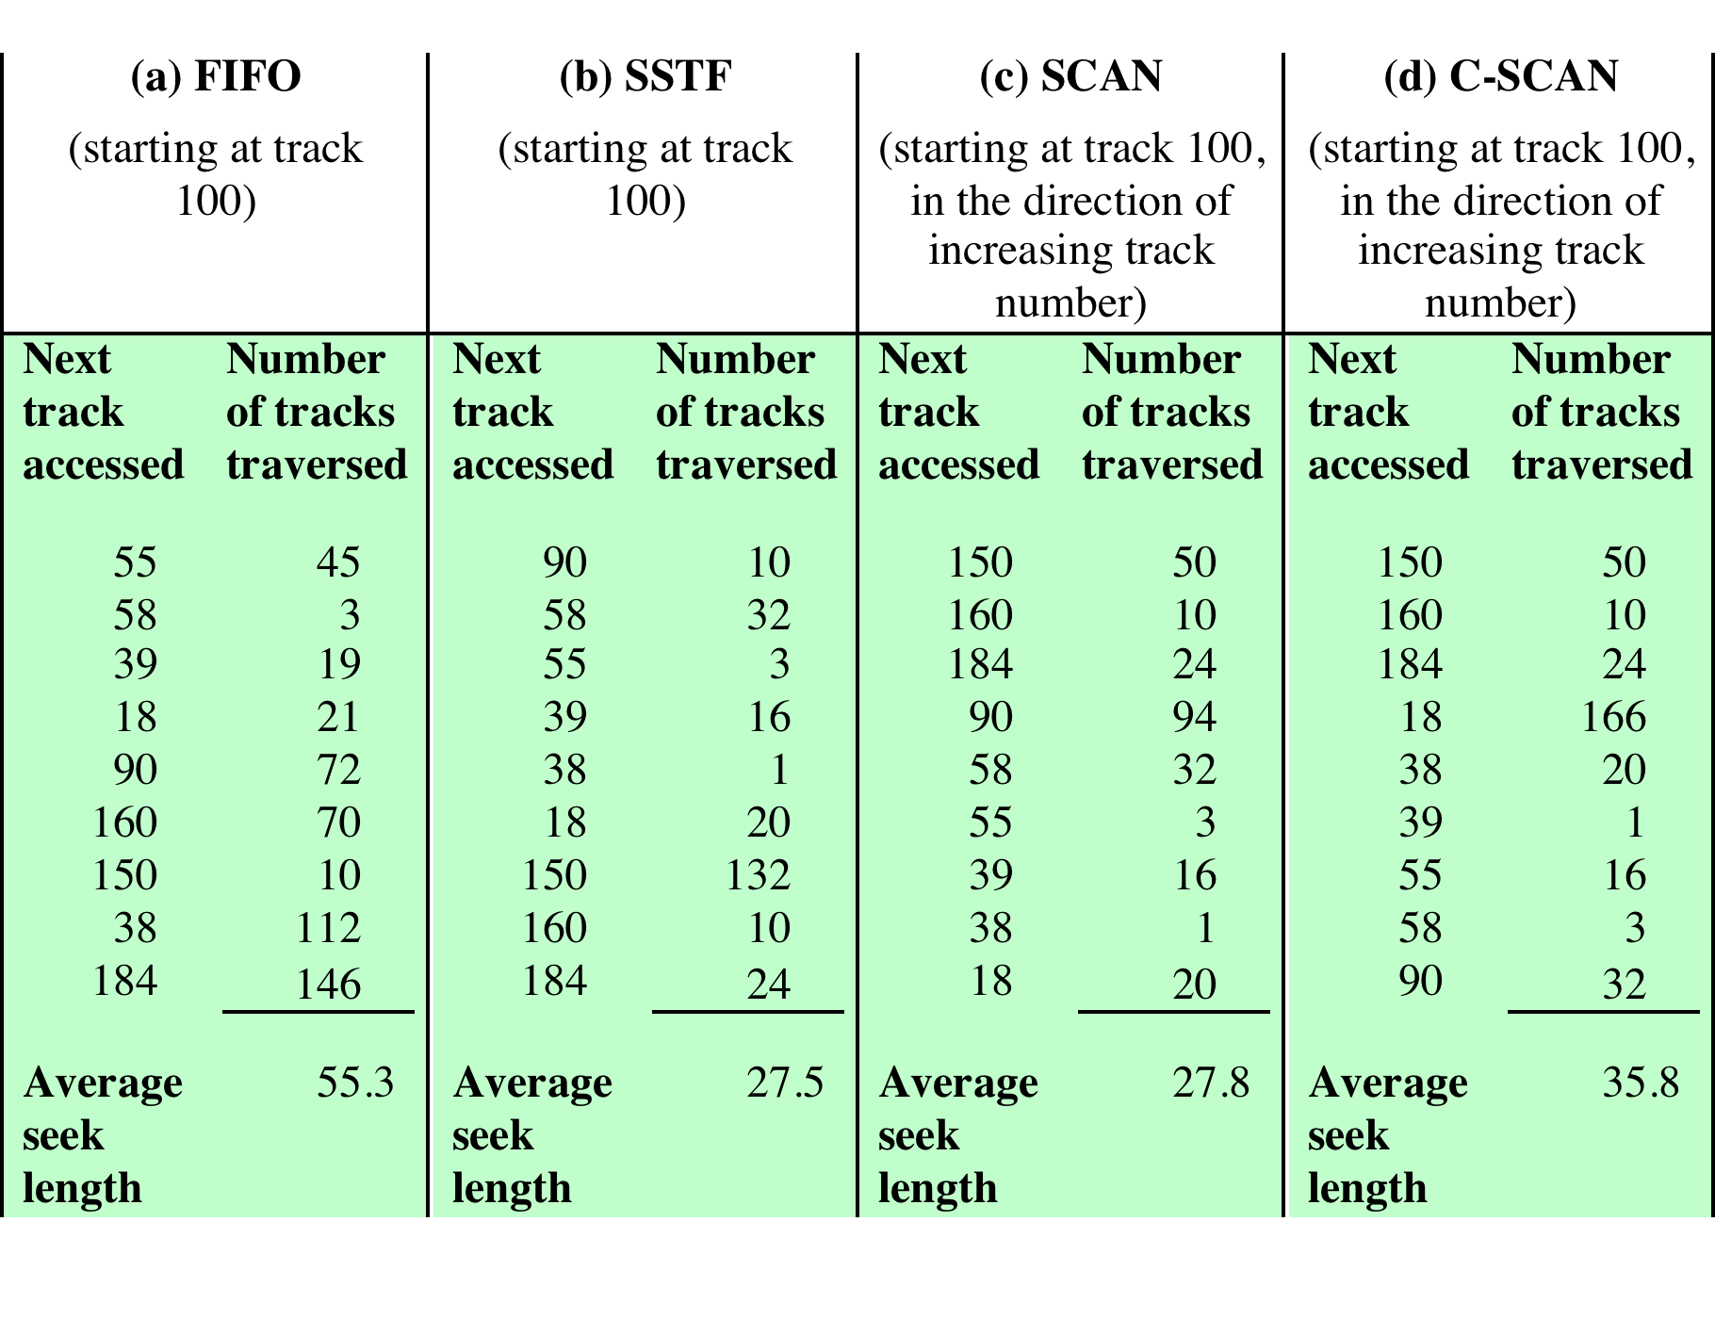
Table 11.2 Comparison of Disk Scheduling Algorithms
Notes:
Table 11.2 Comparison of Disk Scheduling Algorithms

Slide 30
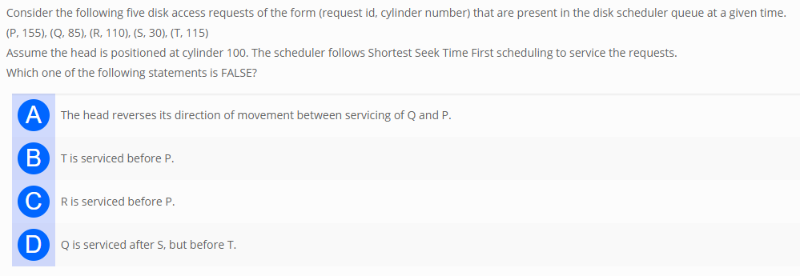
Exercise
Ans- D
Notes:
Table 11.2 Comparison of Disk Scheduling Algorithms

Slide 31
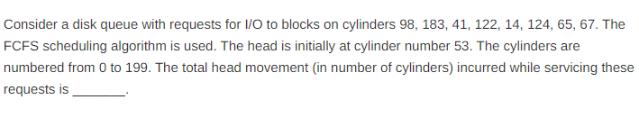
Exercise
Apply all scheduling algorthms on the given question. Assume direction of head movement as DOWN
Notes:
Table 11.2 Comparison of Disk Scheduling Algorithms

Slide 32

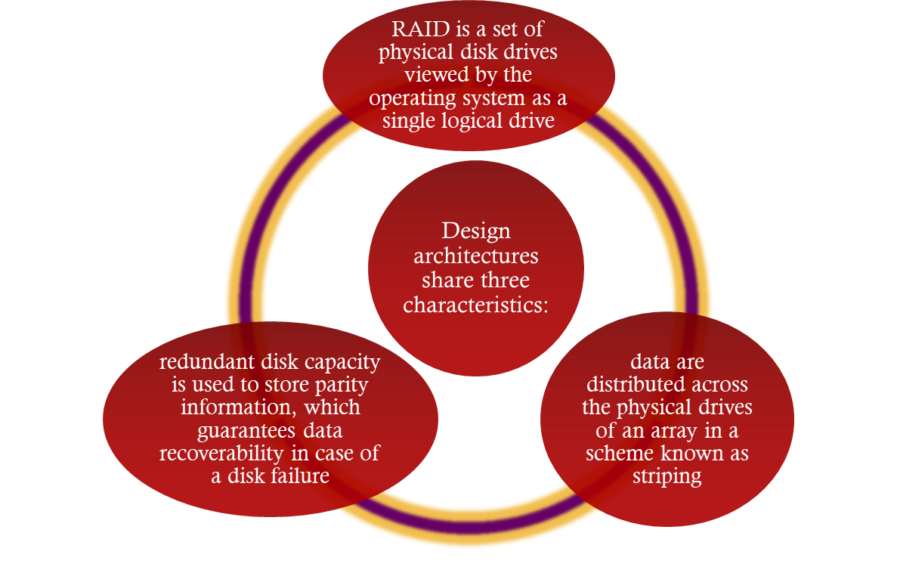
Redundant Array of Independent Disks
Consists of seven levels, zero through six
Notes:
With the use of multiple disks, there is a wide variety of ways in which the data
can be organized and in which redundancy can be added to improve reliability. This
could make it difficult to develop database schemes that are usable on a number of
platforms and operating systems. Fortunately, industry has agreed on a standardized
scheme for multiple-disk database design, known as RAID (redundant array of
independent disks). The RAID scheme consists of seven levels, 2 zero through six.
These levels do not imply a hierarchical relationship but designate different design
architectures that share three common characteristics:
1. RAID is a set of physical disk drives viewed by the operating system as a single
logical drive.
2. Data are distributed across the physical drives of an array in a scheme known
as striping, described subsequently.
3. Redundant disk capacity is used to store parity information, which guarantees
data recoverability in case of a disk failure.

Slide 33
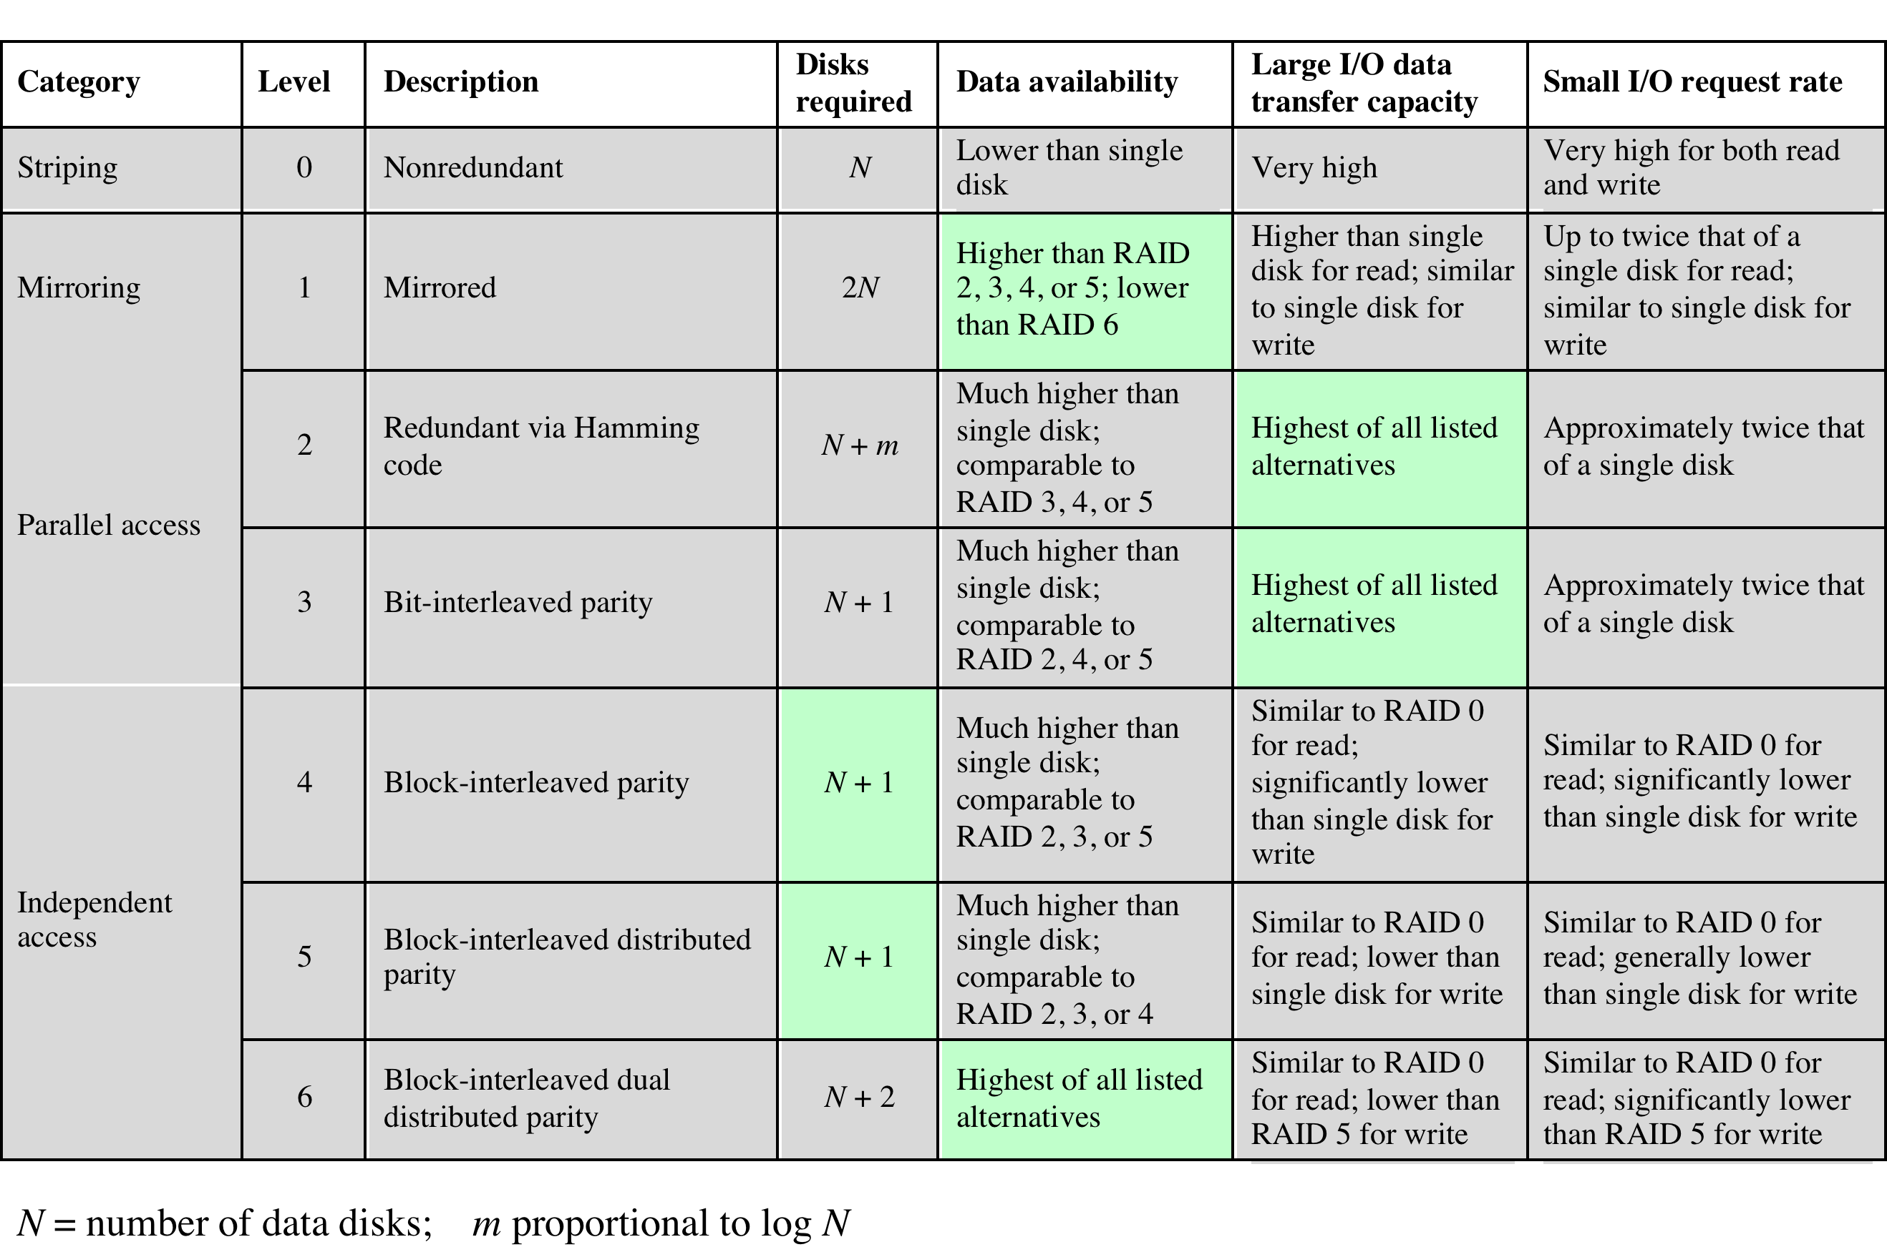
Table 11.4 RAID Levels
Notes:
We now examine each of the RAID levels. Table 11.4 provides a rough
guide to the seven levels. In the table, I/O performance is shown both in terms of
data transfer capacity, or ability to move data, and I/O request rate, or ability to
satisfy I/O requests, since these RAID levels inherently perform differently relative
to these two metrics. Each RAID level’s strong point is highlighted in color.
Of the seven RAID levels described, only four are commonly used: RAID
levels 0, 1, 5, and 6.

Slide 34
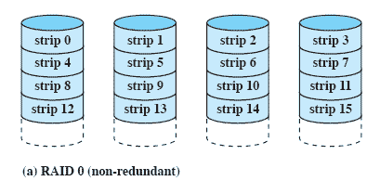
RAID Level 0
Not a true RAID because it does not include redundancy to improve performance or provide data protection
User and system data are distributed across all of the disks in the array
Logical disk is divided into strips
Notes:
RAID level 0 is not a true member of the RAID family, because it does not include
redundancy to improve performance or provide data protection. However, there
are a few applications, such as some on supercomputers in which performance
and capacity are primary concerns and low cost is more important than improved
reliability.
For RAID 0, the user and system data are distributed across all of the disks
in the array. This has a notable advantage over the use of a single large disk: If two
different I/O requests are pending for two different blocks of data, then there is a
good chance that the requested blocks are on different disks. Thus, the two requests
can be issued in parallel, reducing the I/O queuing time.
But RAID 0, as with all of the RAID levels, goes further than simply distributing
the data across a disk array: The data are striped across the available disks.
This is best understood by considering Figure 11.8 . All user and system data are
viewed as being stored on a logical disk. The logical disk is divided into strips; these
strips may be physical blocks, sectors, or some other unit. The strips are mapped
round robin to consecutive physical disks in the RAID array. A set of logically
consecutive strips that maps exactly one strip to each array member is referred
to as a stripe . In an n -disk array, the first n logical strips are physically stored as
the first strip on each of the n disks, forming the first stripe; the second n strips
are distributed as the second strips on each disk; and so on. The advantage of this
layout is that if a single I/O request consists of multiple logically contiguous strips,
then up to n strips for that request can be handled in parallel, greatly reducing the
I/O transfer time.

Slide 35
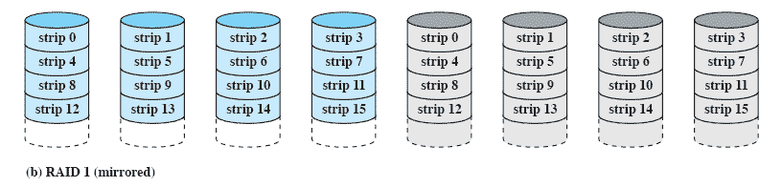
RAID Level 1
Redundancy is achieved by the simple expedient of duplicating all the data
There is no “write penalty”
When a drive fails the data may still be accessed from the second drive
Principal disadvantage is the cost
Notes:
RAID 1 differs from RAID levels 2 through 6 in the way in which redundancy is
achieved. In these other RAID schemes, some form of parity calculation is used
to introduce redundancy, whereas in RAID 1, redundancy is achieved by the simple
expedient of duplicating all the data. Figure 11.8b shows data striping being
used, as in RAID 0. But in this case, each logical strip is mapped to two separate
physical disks so that every disk in the array has a mirror disk that contains the
same data. RAID 1 can also be implemented without data striping, though this is
less common.
There are a number of positive aspects to the RAID 1 organization:
1. A read request can be serviced by either of the two disks that contains the
requested data, whichever one involves the minimum seek time plus rotational
latency.
2. A write request requires that both corresponding strips be updated, but this
can be done in parallel. Thus, the write performance is dictated by the slower
of the two writes (i.e., the one that involves the larger seek time plus rotational
latency). However, there is no “write penalty” with RAID 1. RAID levels
2 through 6 involve the use of parity bits. Therefore, when a single strip is
updated, the array management software must first compute and update the
parity bits as well as updating the actual strip in question.
3. Recovery from a failure is simple. When a drive fails, the data may still be
accessed from the second drive.
The principal disadvantage of RAID 1 is the cost; it requires twice the disk
space of the logical disk that it supports. Because of that, a RAID 1 configuration
is likely to be limited to drives that store system software and data and other highly
critical files. In these cases, RAID 1 provides real-time backup of all data so that in
the event of a disk failure, all of the critical data is still immediately available.
In a transaction-oriented environment, RAID 1 can achieve high I/O request
rates if the bulk of the requests are reads. In this situation, the performance of RAID
1 can approach double of that of RAID 0. However, if a substantial fraction of the I/O
requests are write requests, then there may be no significant performance gain over
RAID 0. RAID 1 may also provide improved performance over RAID 0 for data
transfer intensive applications with a high percentage of reads. Improvement occurs
if the application can split each read request so that both disk members participate.

Slide 36
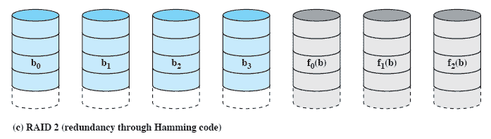
RAID Level 2
Makes use of a parallel access technique
Data striping is used
Typically a Hamming code is used
Effective choice in an environment in which many disk errors occur
Notes:
RAID levels 2 and 3 make use of a parallel access technique. In a parallel access
array, all member disks participate in the execution of every I/O request. Typically,
the spindles of the individual drives are synchronized so that each disk head is in the
same position on each disk at any given time.
As in the other RAID schemes, data striping is used. In the case of RAID 2
and 3, the strips are very small, often as small as a single byte or word. With RAID 2,
an error-correcting code is calculated across corresponding bits on each data disk,
and the bits of the code are stored in the corresponding bit positions on multiple
parity disks. Typically, a Hamming code is used, which is able to correct single-bit
errors and detect double-bit errors.
Although RAID 2 requires fewer disks than RAID 1, it is still rather costly.
The number of redundant disks is proportional to the log of the number of data
disks. On a single read, all disks are simultaneously accessed. The requested data
and the associated error-correcting code are delivered to the array controller. If
there is a single-bit error, the controller can recognize and correct the error instantly,
so that the read access time is not slowed. On a single write, all data disks and parity
disks must be accessed for the write operation.
RAID 2 would only be an effective choice in an environment in which many
disk errors occur. Given the high reliability of individual disks and disk drives,
RAID 2 is overkill and is not implemented.

Slide 37
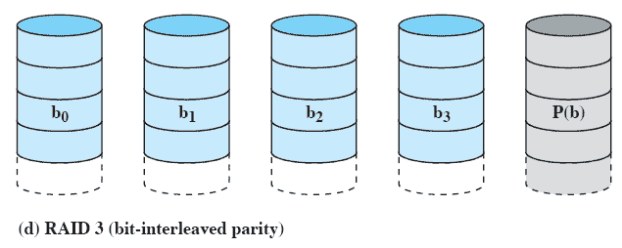
RAID Level 3
Requires only a single redundant disk, no matter how large the disk array
Employs parallel access, with data distributed in small strips
Can achieve very high data transfer rates
Notes:
RAID 3 is organized in a similar fashion to RAID 2. The difference is that RAID 3
requires only a single redundant disk, no matter how large the disk array. RAID 3
employs parallel access, with data distributed in small strips. Instead of an error correcting
code, a simple parity bit is computed for the set of individual bits in the
same position on all of the data disks.
REDUNDANCY In the event of a drive failure, the parity drive is accessed and data
is reconstructed from the remaining devices. Once the failed drive is replaced, the
missing data can be restored on the new drive and operation resumed.
Data reconstruction is simple. Consider an array of five drives in which X0
through X3 contain data and X4 is the parity disk. The parity for the i th bit is
calculated as follows:
X4(i) = X3(i) X2(i) X1(i) X0(i)
where is exclusive-OR function.
Suppose that drive X1 has failed. If we add X4(i) X1(i) to both sides of the
preceding equation, we get
X1(i) = X4(i) X3(i) X2(i) X0(i)
Thus, the contents of each strip of data on X1 can be regenerated from the contents
of the corresponding strips on the remaining disks in the array. This principle is true
for RAID levels 3 through 6.
In the event of a disk failure, all of the data are still available in what is referred
to as reduced mode. In this mode, for reads, the missing data are regenerated on the
fly using the exclusive-OR calculation. When data are written to a reduced RAID 3
array, consistency of the parity must be maintained for later regeneration. Return to
full operation requires that the failed disk be replaced and the entire contents of the
failed disk be regenerated on the new disk.
PERFORMANCE Because data are striped in very small strips, RAID 3 can achieve
very high data transfer rates. Any I/O request will involve the parallel transfer of
data from all of the data disks. For large transfers, the performance improvement is
especially noticeable. On the other hand, only one I/O request can be executed at a
time. Thus, in a transaction-oriented environment, performance suffers.

Slide 38
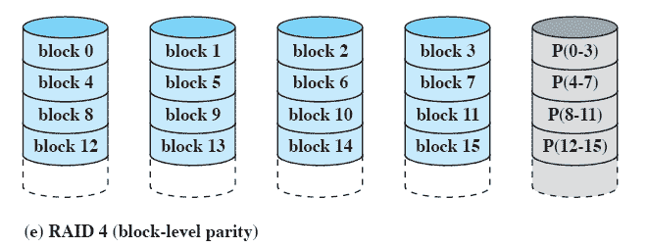
RAID Level 4
Makes use of an independent access technique
A bit-by-bit parity strip is calculated across corresponding strips on each data disk, and the parity bits are stored in the corresponding strip on the parity disk
Involves a write penalty when an I/O write request of small size is performed
Notes:
RAID levels 4 through 6 make use of an independent access technique. In an independent
access array, each member disk operates independently, so that separate
I/O requests can be satisfied in parallel. Because of this, independent access arrays
are more suitable for applications that require high I/O request rates and are relatively
less suited for applications that require high data transfer rates.
As in the other RAID schemes, data striping is used. In the case of RAID
4 through 6, the strips are relatively large. With RAID 4, a bit-by-bit parity strip
is calculated across corresponding strips on each data disk, and the parity bits are
stored in the corresponding strip on the parity disk.
RAID 4 involves a write penalty when an I/O write request of small size is performed.
Each time that a write occurs, the array management software must update
not only the user data but also the corresponding parity bits. Consider an array of
five drives in which X0 through X3 contain data and X4 is the parity disk. Suppose
that a write is performed that only involves a strip on disk X1. Initially, for each bit
i , we have the following relationship:
X4(i) = X3(i) X2(i) X1(i) X0(i) (11.1)
After the update, with potentially altered bits indicated by a prime symbol:
X4=(i) = X3(i) X2(i) X1=(i) X0(i)
= X3(i) X2(i) X1=(i) X0(i) X1(i) X1(i)
= X3(i) X2(i) X1 (i) X0(i) X1(i) X1=(i)
= X4(i) X1(i) X1=(i)
The preceding set of equations is derived as follows. The first line shows that
a change in X1 will also affect the parity disk X4. In the second line, we add the
terms [ X1(i) X1(i)] . Because the exclusive-OR of any quantity with itself
is 0, this does not affect the equation. However, it is a convenience that is used to
create the third line, by reordering. Finally, Equation ( 11.1 ) is used to replace the
first four terms by X4( i ).
To calculate the new parity, the array management software must read the old
user strip and the old parity strip. Then it can update these two strips with the new
data and the newly calculated parity. Thus, each strip write involves two reads and
two writes.
In the case of a larger size I/O write that involves strips on all disk drives, parity
is easily computed by calculation using only the new data bits. Thus, the parity drive
can be updated in parallel with the data drives and there are no extra reads or writes.
In any case, every write operation must involve the parity disk, which therefore
can become a bottleneck.

Slide 39
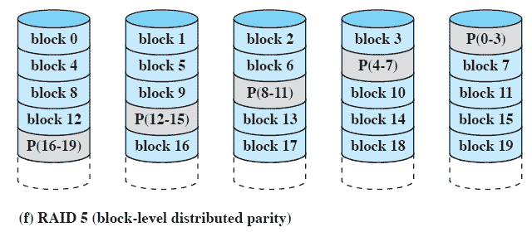
RAID Level 5
Similar to RAID-4 but distributes the parity bits across all disks
Typical allocation is a round-robin scheme
Has the characteristic that the loss of any one disk does not result in data loss
Notes:
RAID 5 is organized in a similar fashion to RAID 4. The difference is that RAID
5 distributes the parity strips across all disks. A typical allocation is a round-robin
scheme, as illustrated in Figure 11.8f . For an n -disk array, the parity strip is on a
different disk for the first n stripes, and the pattern then repeats.
The distribution of parity strips across all drives avoids the potential I/O
bottleneck of the single parity disk found in RAID 4. Further, RAID 5 has the
characteristic that the loss of any one disk does not result in data loss.

Slide 40
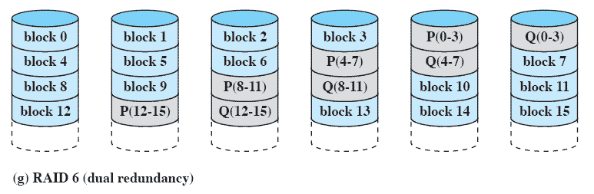
RAID Level 6
Two different parity calculations are carried out and stored in separate blocks on different disks
Provides extremely high data availability
Incurs a substantial write penalty because each write affects two parity blocks
Notes:
RAID 6 was introduced in a subsequent paper by the Berkeley researchers
[KATZ89]. In the RAID 6 scheme, two different parity calculations are carried out
and stored in separate blocks on different disks. Thus, a RAID 6 array whose user
data require N disks consists of N + 2 disks.
Figure 11.8g illustrates the scheme. P and Q are two different data check algorithms.
One of the two is the exclusive-OR calculation used in RAID 4 and 5. But
the other is an independent data check algorithm. This makes it possible to regenerate
data even if two disks containing user data fail.
The advantage of RAID 6 is that it provides extremely high data availability.
Three disks would have to fail within the MTTR (mean time to repair) interval to
cause data to be lost. On the other hand, RAID 6 incurs a substantial write penalty,
because each write affects two parity blocks. Performance benchmarks [EISC07]
show a RAID 6 controller can suffer more than a 30% drop in overall write performance
compared with a RAID 5 implementation. RAID 5 and RAID 6 read
performance is comparable.

Slide 41

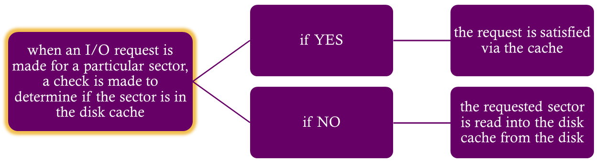
Cache memory is used to apply to a memory that is smaller and faster than main memory and that is interposed between main memory and the processor
Reduces average memory access time by exploiting the principle of locality
Disk cache is a buffer in main memory for disk sectors
Contains a copy of some of the sectors on the disk
Notes:
In Section 1.6 and Appendix 1A, we summarized the principles of cache memory.
The term cache memory is usually used to apply to a memory that is smaller and
faster than main memory and that is interposed between main memory and the
processor. Such a cache memory reduces average memory access time by exploiting
the principle of locality.
The same principle can be applied to disk memory. Specifically, a disk cache
is a buffer in main memory for disk sectors. The cache contains a copy of some of
the sectors on the disk. When an I/O request is made for a particular sector, a check
is made to determine if the sector is in the disk cache. If so, the request is satisfied
via the cache. If not, the requested sector is read into the disk cache from the disk.
Because of the phenomenon of locality of reference, when a block of data is fetched
into the cache to satisfy a single I/O request, it is likely that there will be future
references to that same block.

Slide 42

I/O architecture is the computer system’s interface to the outside world
I/O functions are generally broken up into a number of layers
  A key aspect of I/O is the use of buffers that are controlled by I/O utilities rather than by application processes
  Buffering smoothes out the differences between the speeds
  The use of buffers also decouples the actual I/O transfer from the address space of the application process
  Disk I/O has the greatest impact on overall system performance
  Two of the most widely used approaches are disk scheduling and the disk cache
  A disk cache is a buffer, usually kept in main memory, that functions as a cache of disk block between disk memory and the rest of main memory
Notes:
The computer system’s interface to the outside world is its I/O architecture. This
architecture is designed to provide a systematic means of controlling interaction
with the outside world and to provide the operating system with the information it
needs to manage I/O activity effectively.
The I/O function is generally broken up into a number of layers, with lower
layers dealing with details that are closer to the physical functions to be performed
and higher layers dealing with I/O in a logical and generic fashion. The result is that
changes in hardware parameters need not affect most of the I/O software.
A key aspect of I/O is the use of buffers that are controlled by I/O utilities
rather than by application processes. Buffering smoothes out the differences
between the internal speeds of the computer system and the speeds of I/O devices.
The use of buffers also decouples the actual I/O transfer from the address space
of the application process. This allows the operating system more flexibility in
performing its memory-management function.
The aspect of I/O that has the greatest impact on overall system performance
is disk I/O. Accordingly, there has been greater research and design effort in this
area than in any other kind of I/O. Two of the most widely used approaches to
improve disk I/O performance are disk scheduling and the disk cache.
At any time, there may be a queue of requests for I/O on the same disk. It is
the object of disk scheduling to satisfy these requests in a way that minimizes the
mechanical seek time of the disk and hence improves performance. The physical
layout of pending requests plus considerations of locality come into play.
A disk cache is a buffer, usually kept in main memory, that functions as a
cache of disk blocks between disk memory and the rest of main memory. Because
of the principle of locality, the use of a disk cache should substantially reduce the
number of block I/O transfers between main memory and disk.

